Slide 1
S1 Computing Science

Slide 2
micro:bit

Slide 3
Morse Code

Slide 4
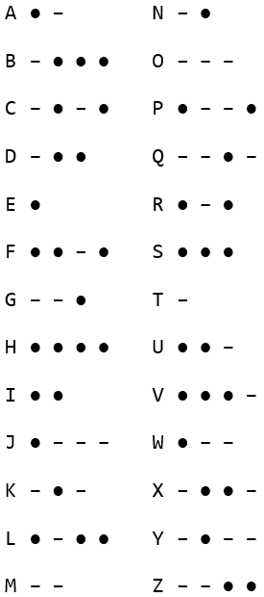
Morse Code
Letters encoded as dots and dashes
E is a single dot: ●
Y is dash dot dash dash : – ● – –
Letters that are used lots are shorter
Can be sent as sound, light, electricity
20
10
5
Notes:
words per minute (wpm)
Titanic: https://www.youtube.com/watch?v=TzUet_MLh8Q

Slide 5
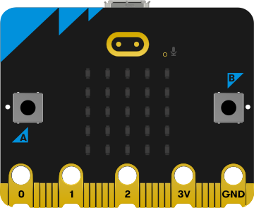

micro:bit Morse
Notes:
Task: https://mrfriendcs.github.io/s1/S1-SDD-Morse/

Slide 6
Brevity Codes
A short code that means something longer
LOL
SOS
- Laugh Out Loud
- Save Our Souls
Notes:
SOS picked as easy to be use, not because it means anything.

